Slide 1
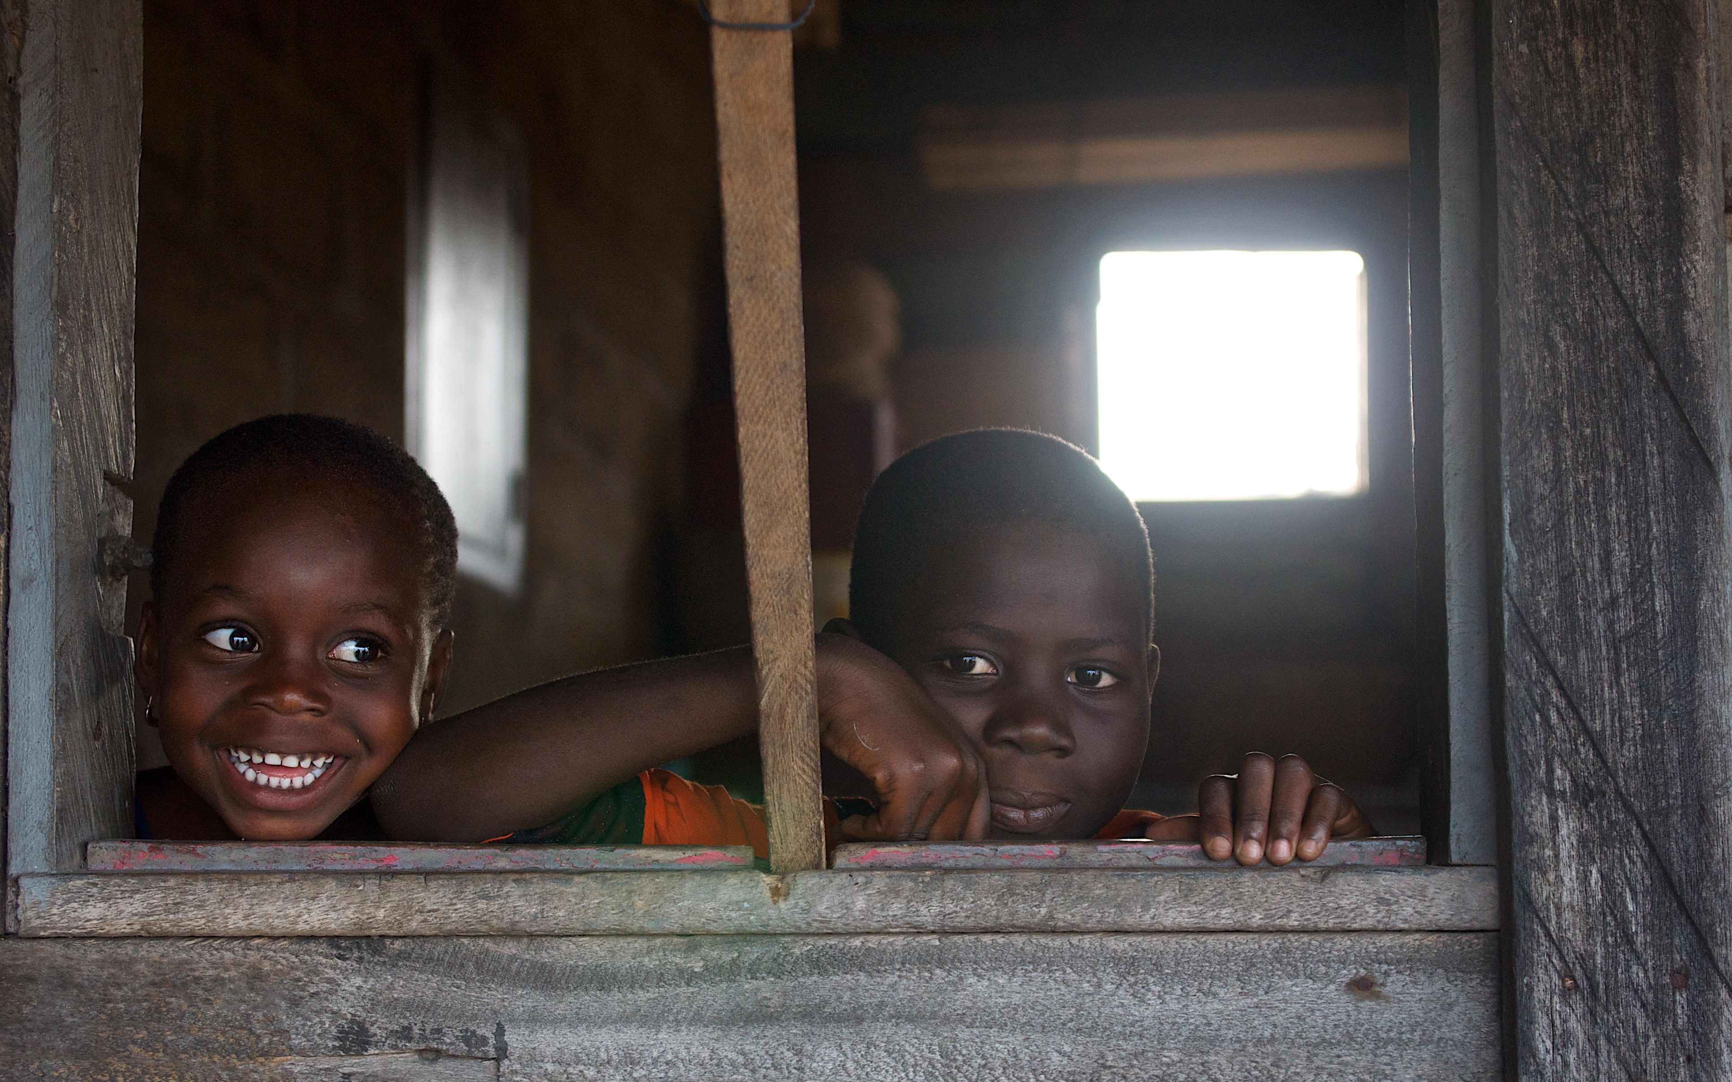
Malaria Kills
Every 59 seconds

Slide 2
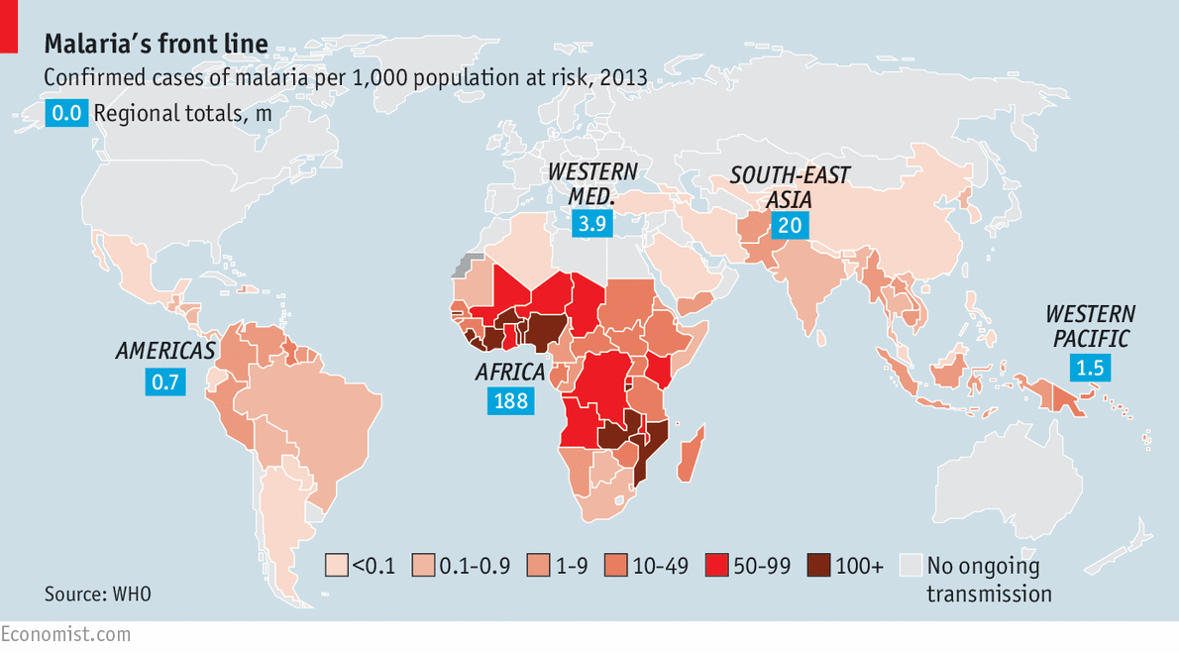
Poner mapa

Slide 3
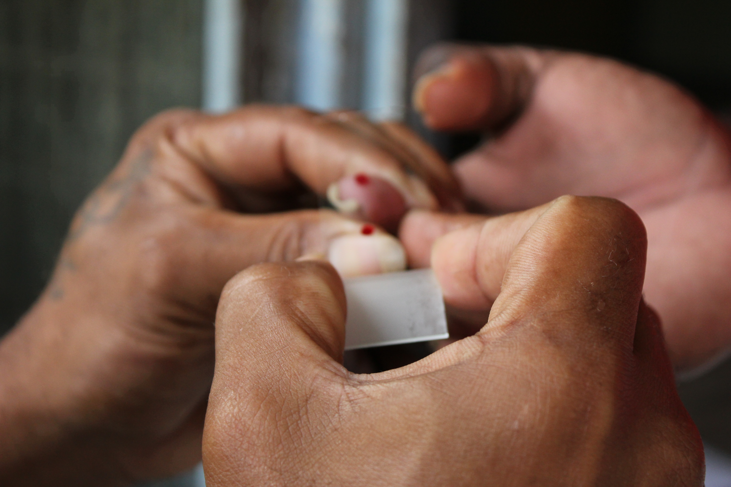
Malaria is curable
only needs quick
Diagnosis

Slide 4
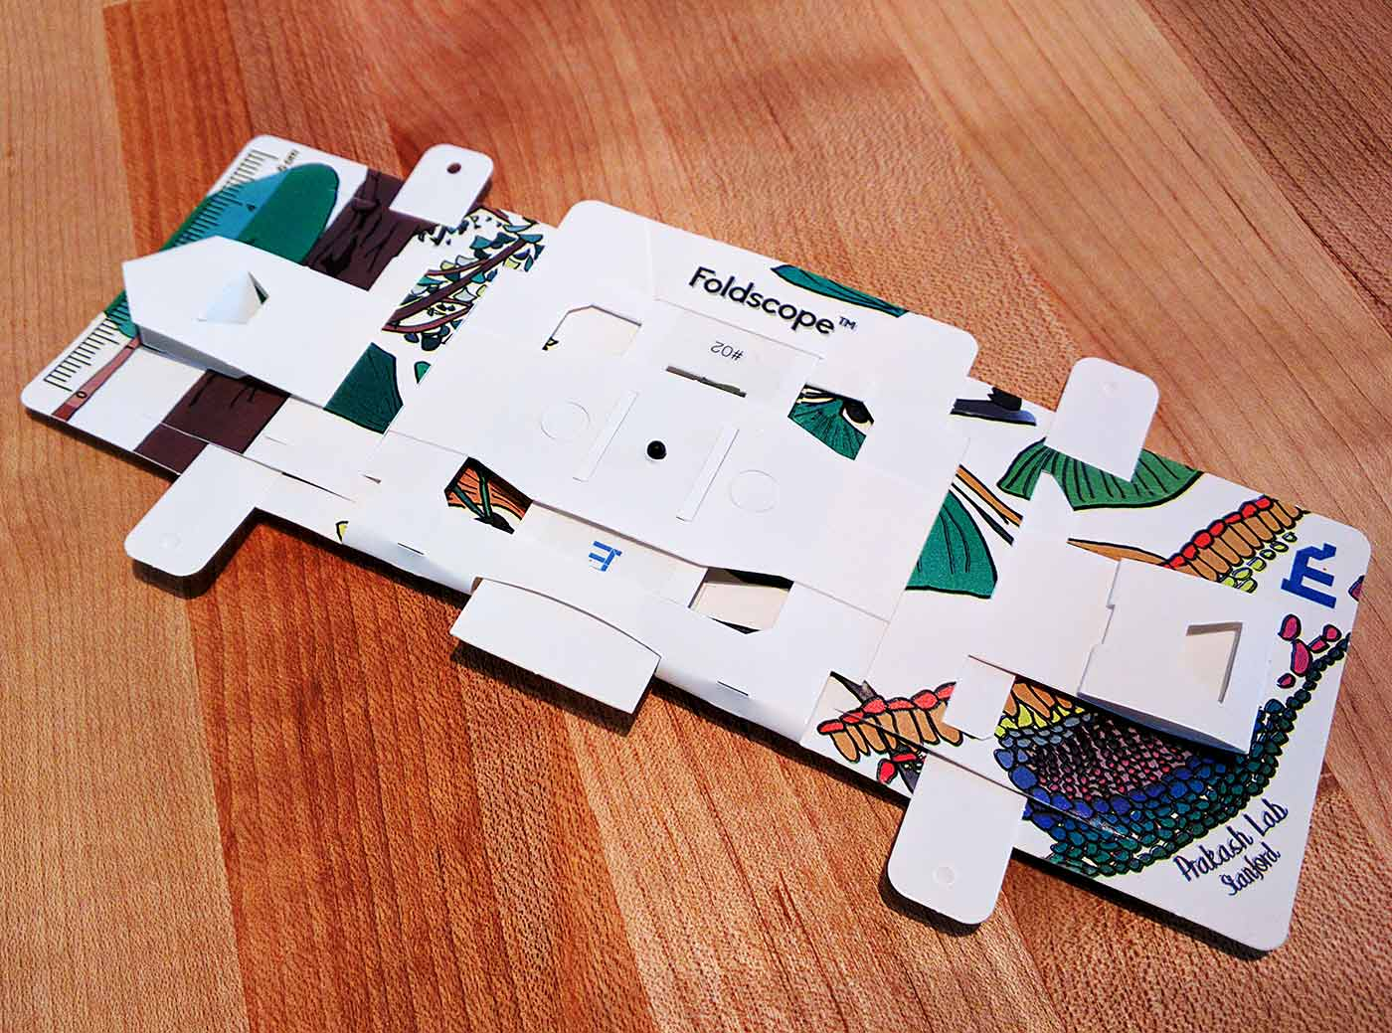
Foldscope

Slide 5
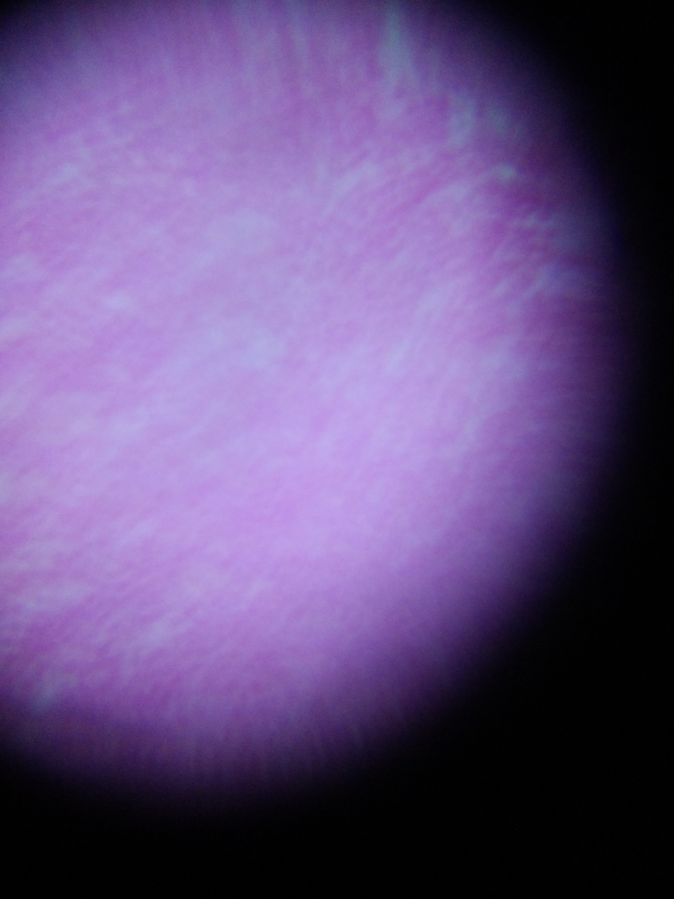
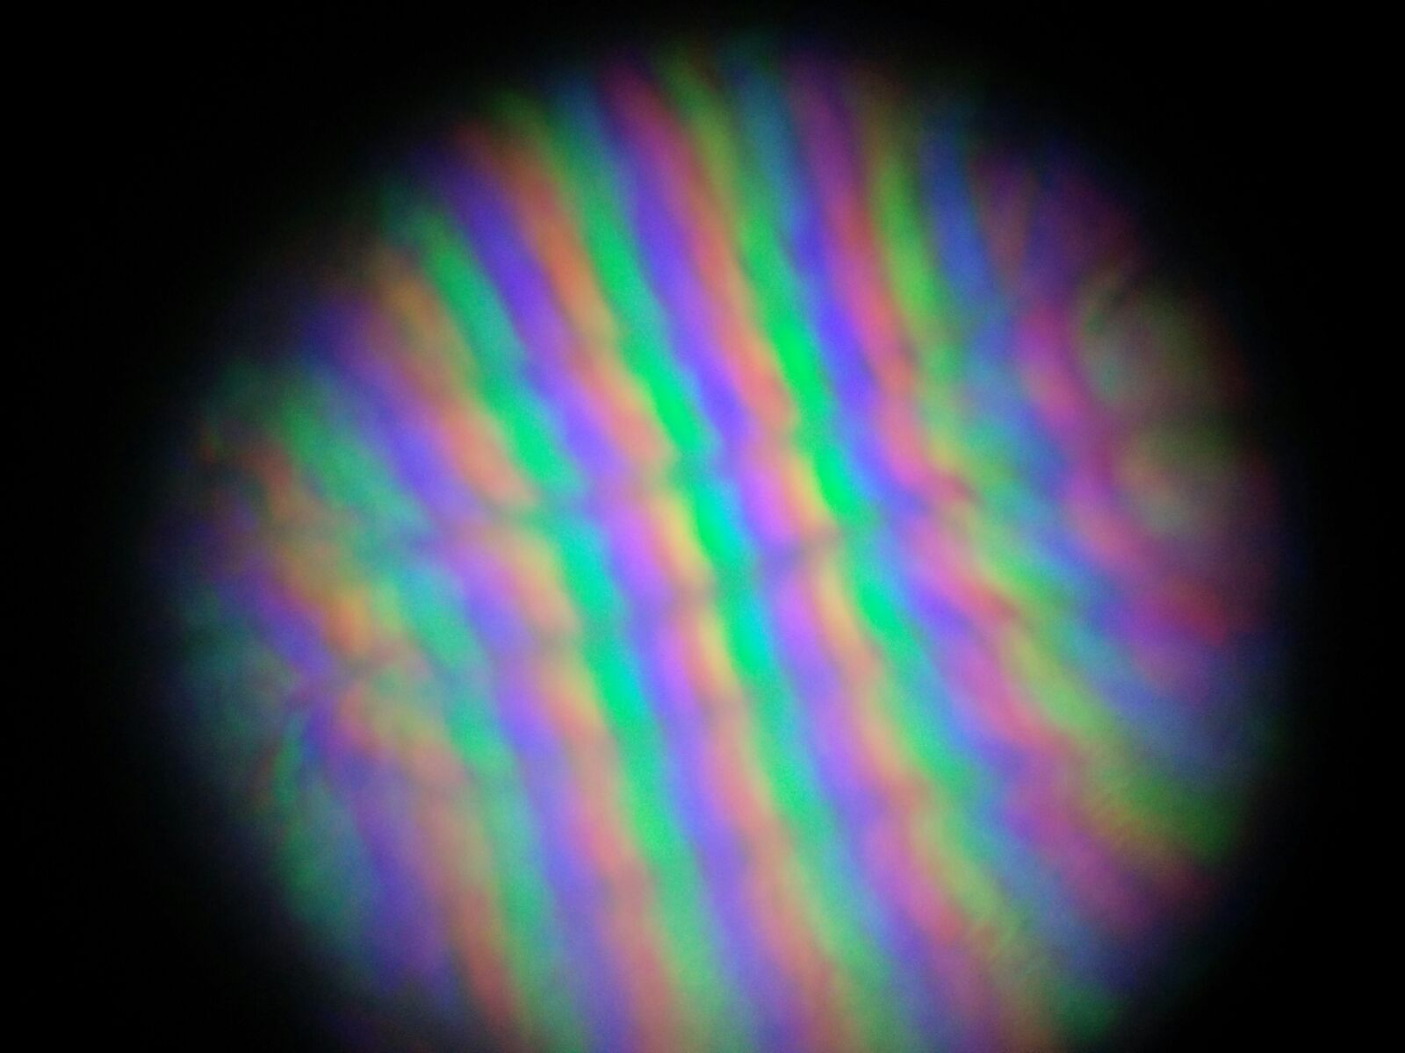
I failed

Slide 6
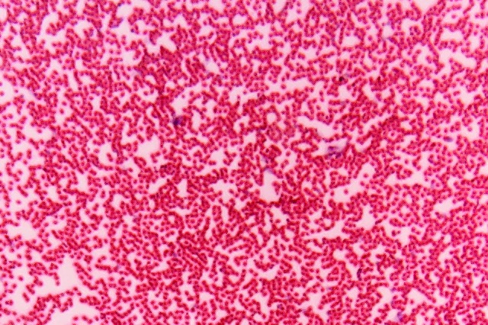
Only 200X

Slide 7


Slide 9
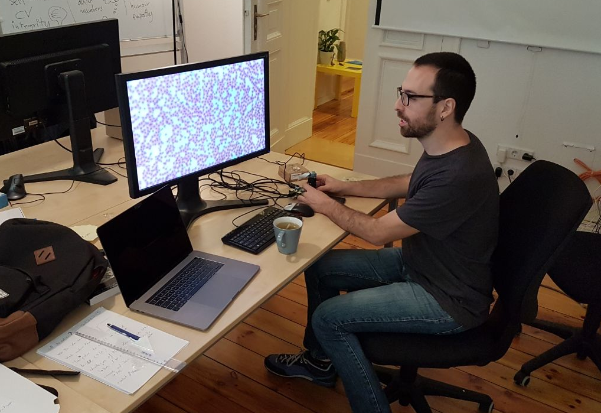
The face of success

Slide 10
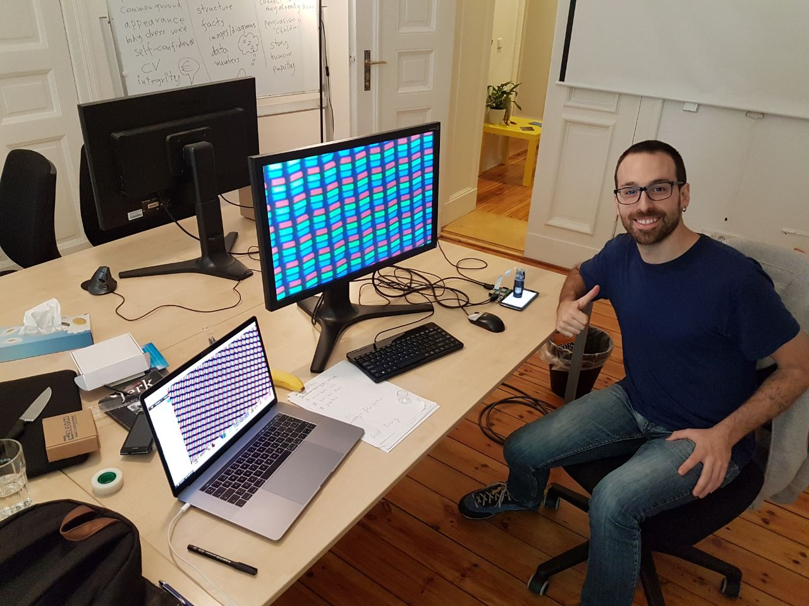

Slide 11
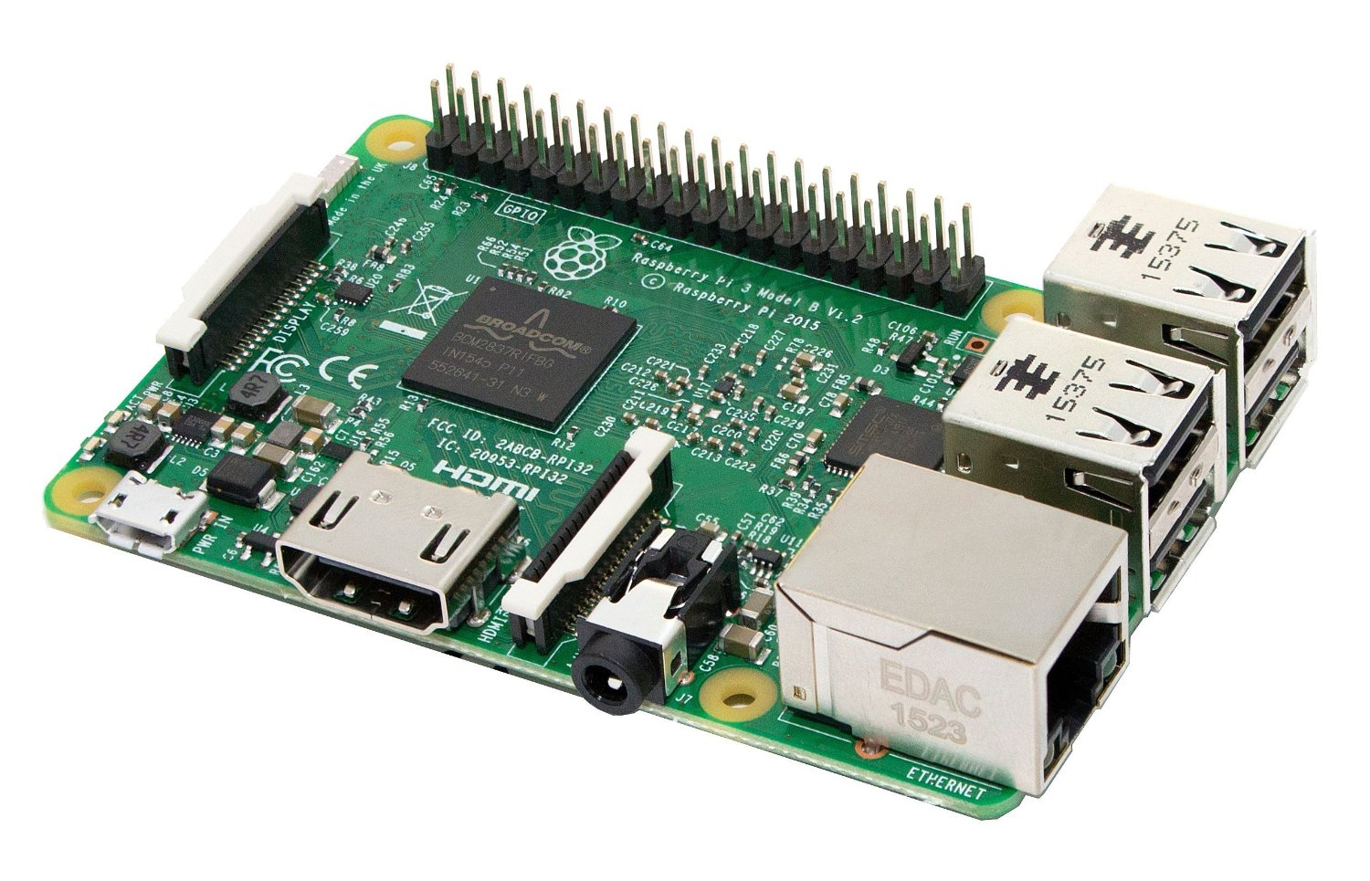
Portable
Cheap
Standard

Slide 12
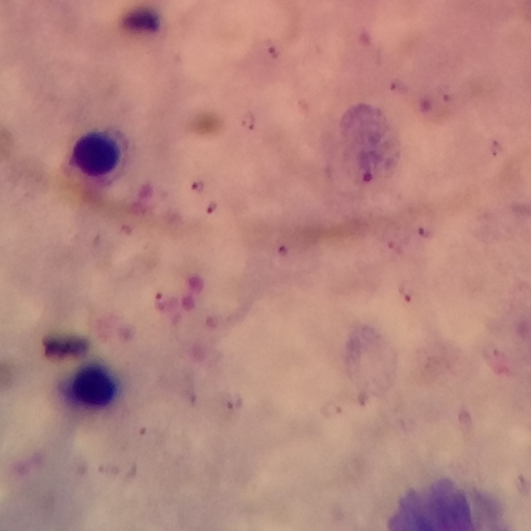

Slide 13
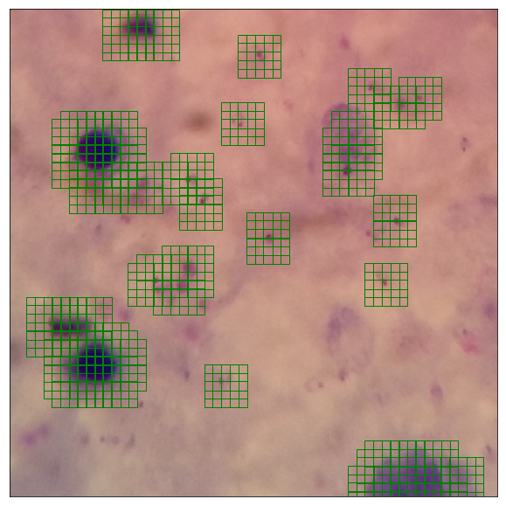
Locate dark areas

Slide 14
Input Data
Apply CNN
Locate parasites

Slide 15
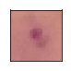
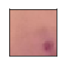
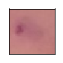
Test model
99%
94%
97%

Slide 16
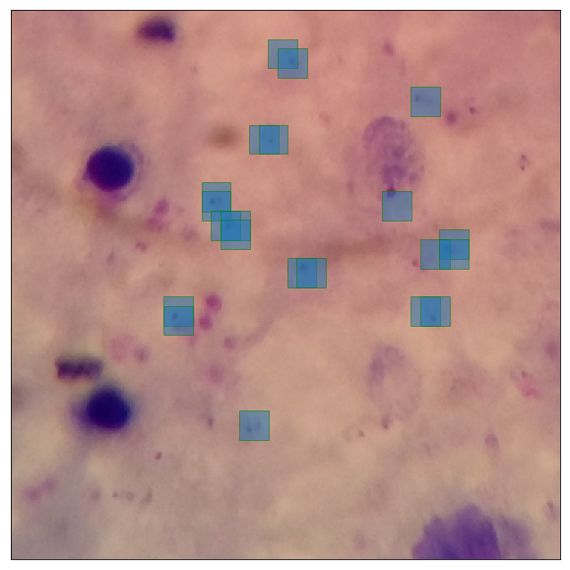
kustering

Slide 17
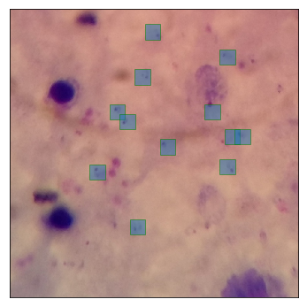

Slide 18
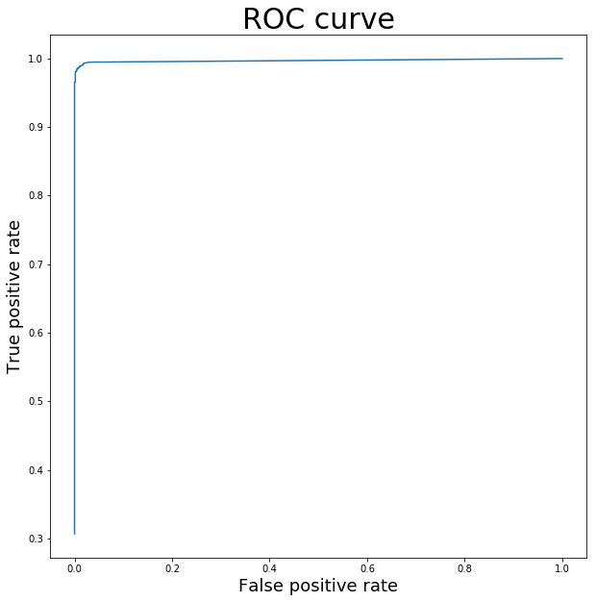
Metrics
Test set
Precision: 0.993
Recall: 0.897

Slide 19

Computer vision can diagnose Malaria

Slide 20

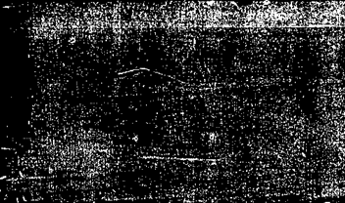
Device under 50€

Slide 21

It’s time to fight malaria
AIscope.net <- Share the project
Eduardo Peire <- contact on linkedin

